Slide 1
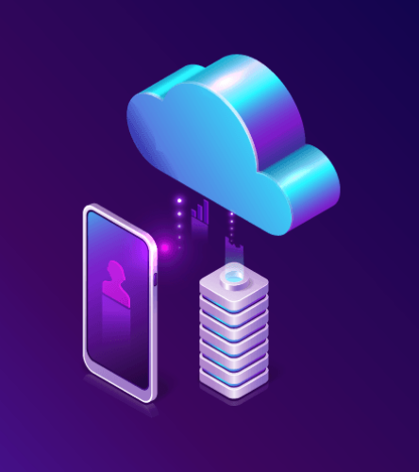
Mobile cloud computing (MCC): Mobile computing +cloud computing
CH Bhavani
19BD1A0568
CSE-D

Slide 2
Why Mobile cloud computing?
Mobile devices face many resource challenges (battery life, storage, bandwidth etc.)
Cloud computing offers advantages to users by allowing them to use infrastructure, platforms and software by cloud providers at low cost and elastically in an on-demand fashion.
Mobile cloud computing provides mobile users with data storage and processing services in clouds, obviating the need to have a powerful device configuration (e.g. CPU speed, memory capacity etc.), as all resource-intensive computing can be performed in the cloud.
With Mobile cloud computing sharing information and applications is easy without the need of complex and costly hardware and software because the business computations are conducted on the cloud.
Mobile phones features and functionality are now enhanced through new cloud applications.
The access point to mobile cloud computing is through a browser and not a mobile operating system there is ease of access.

Slide 3
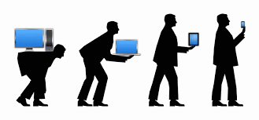
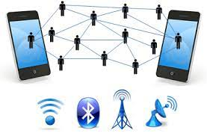
Mobile Computing
Mobile Computing is essentially an interaction between man and machine by way of which a computer is expected to be transported during normal usage which makes it possible to transmit data, voice, and video. It includes mobile communication, hardware, & software for mobile devices.
Issues in Mobile Computing :
Battery life: Mobile devices operate or depend entirely on battery power.so expensive batteries need to be used.
Low bandwidth: The networks for mobile devices will be within the range of cellphone towers. Even though the WLAN’s are inexpensive they were available within limited range.
Networking: Users can move from one place to another place i.e., user may move outside the network which may result in loss of data transmission.
Hardware: Mobile devices with low capacity limit the applications to be developed.
Security: This is considered as the major threat in mobile computing. As huge number of networks is connected within a line, there is a possibility that one can directly attack the VPN.
User interface with device: Use of mobile devices is difficult as screens tend to be small with no mouse and keyboard.

Slide 4
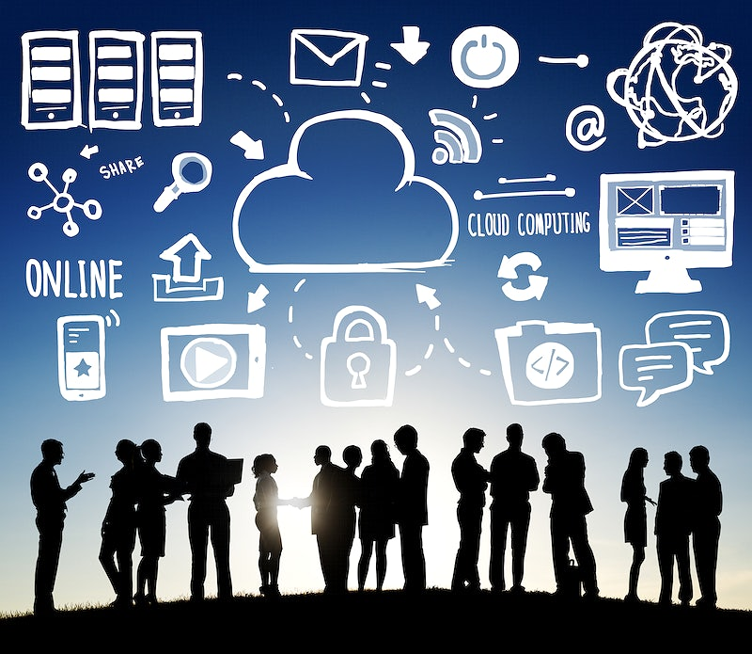
What is cloud computing?
Cloud computing is the on-demand delivery of IT resources over the Internet with pay-as-you-go pricing.
Instead of buying, owning, and maintaining physical data centers and servers, you can access technology services, such as computing power, storage, and databases, on an as-needed basis from a cloud provider like Amazon Web Services (AWS).
Organizations of every type, size, and industry are using the cloud for a wide variety of use cases, such as data backup, disaster recovery, email, virtual desktops, software development and testing, big data analytics, and customer-facing web applications.
Benefits of cloud computing include Agility, Elasticity, Cost saving , Deploy globally in minutes .
94% of all companies worldwide use cloud computing in their operations.
In 2020, more than 80% of company workloads were migrated to the cloud, hastened by the unprecedented circumstances of the pandemic.

Slide 5
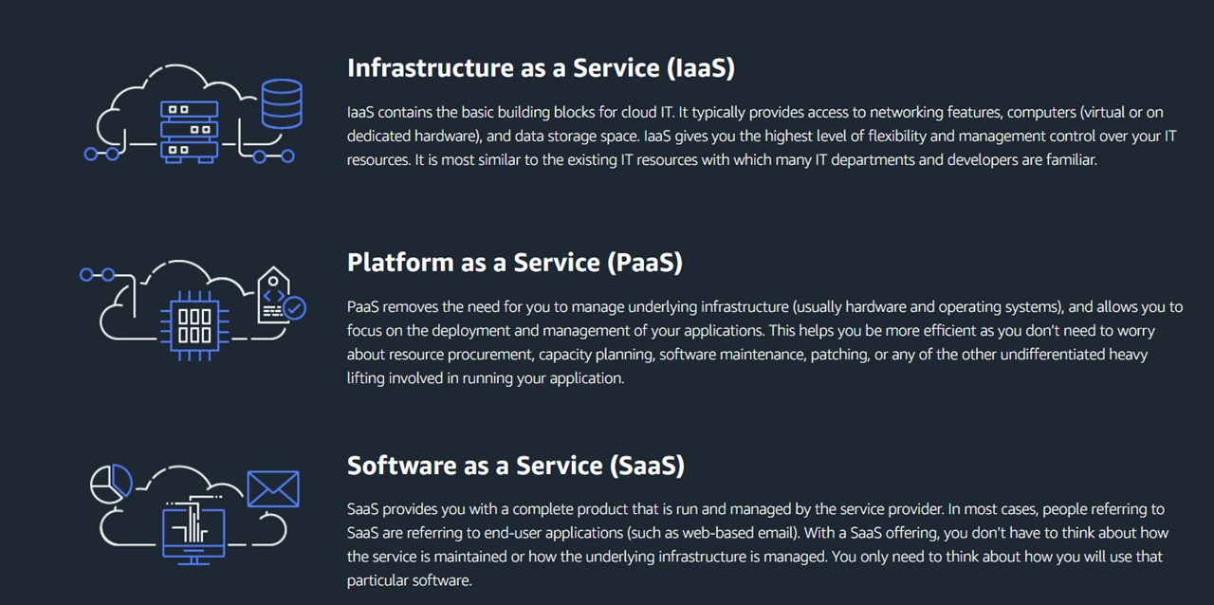
Types of cloud computing

Slide 6

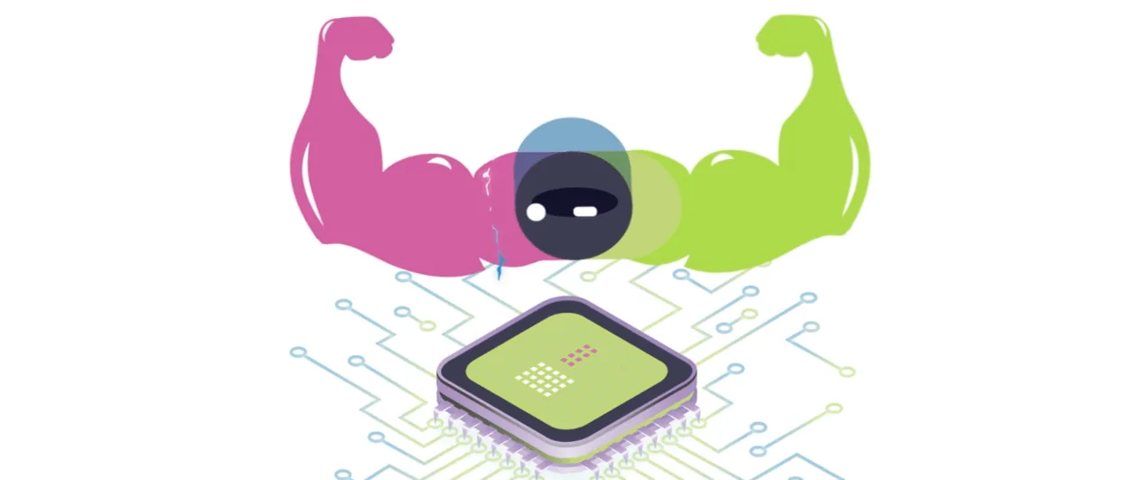
What is Mobile cloud computing?
Mobile Cloud Computing (MCC) is an architectural approach that combines the processing power of mobile devices like smartphones or tablets with cloud-based resources.
At its simplest, MCC refers to an infrastructure where both the data storage and data processing happen outside of the mobile device.
Mobile cloud applications move the computing power and data storage away from the mobile devices and into powerful and centralized computing platforms located in clouds, which are then accessed over the wireless connection based on a thin native client.

Slide 7
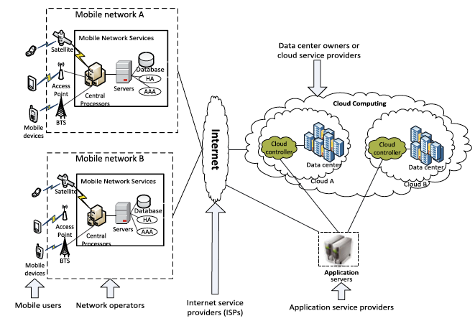
Architecture of MCC
1. Mobile devices are connected to the mobile networks via base stations that establish and control the connections and functional interfaces between the networks and mobile devices.
2. Mobile users’ requests and information are transmitted to the central processors that are connected to servers providing mobile network services.
3. The subscribers’ requests are delivered to a cloud through the Internet.
4. In the cloud, cloud controllers process the requests to provide mobile users with the corresponding cloud services.

Slide 8
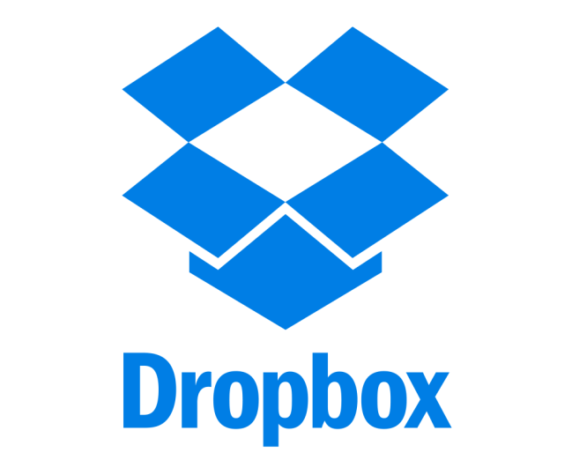
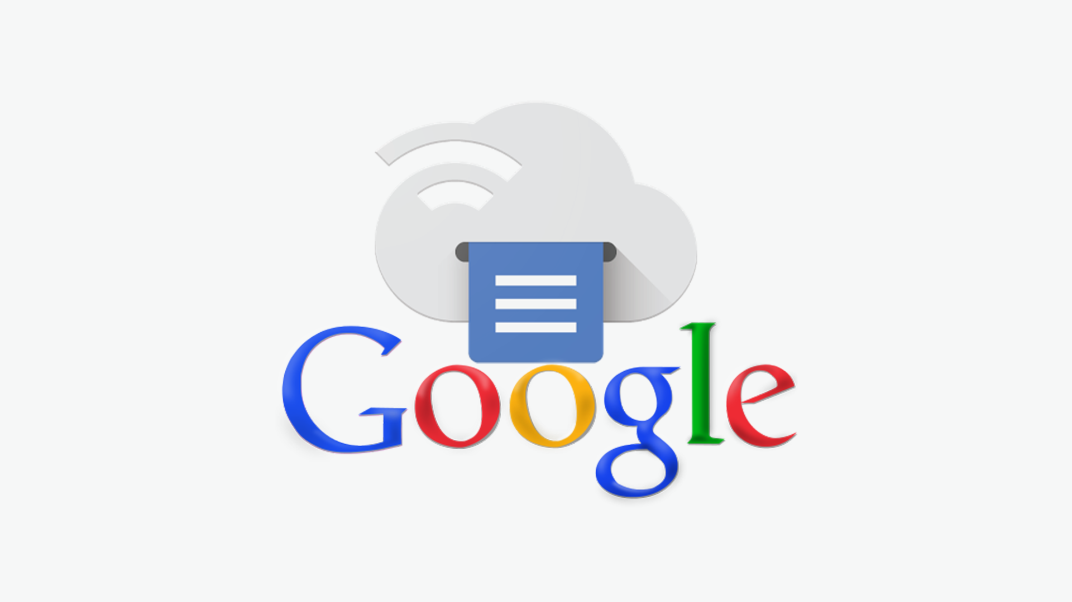
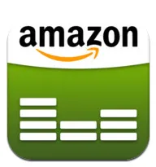
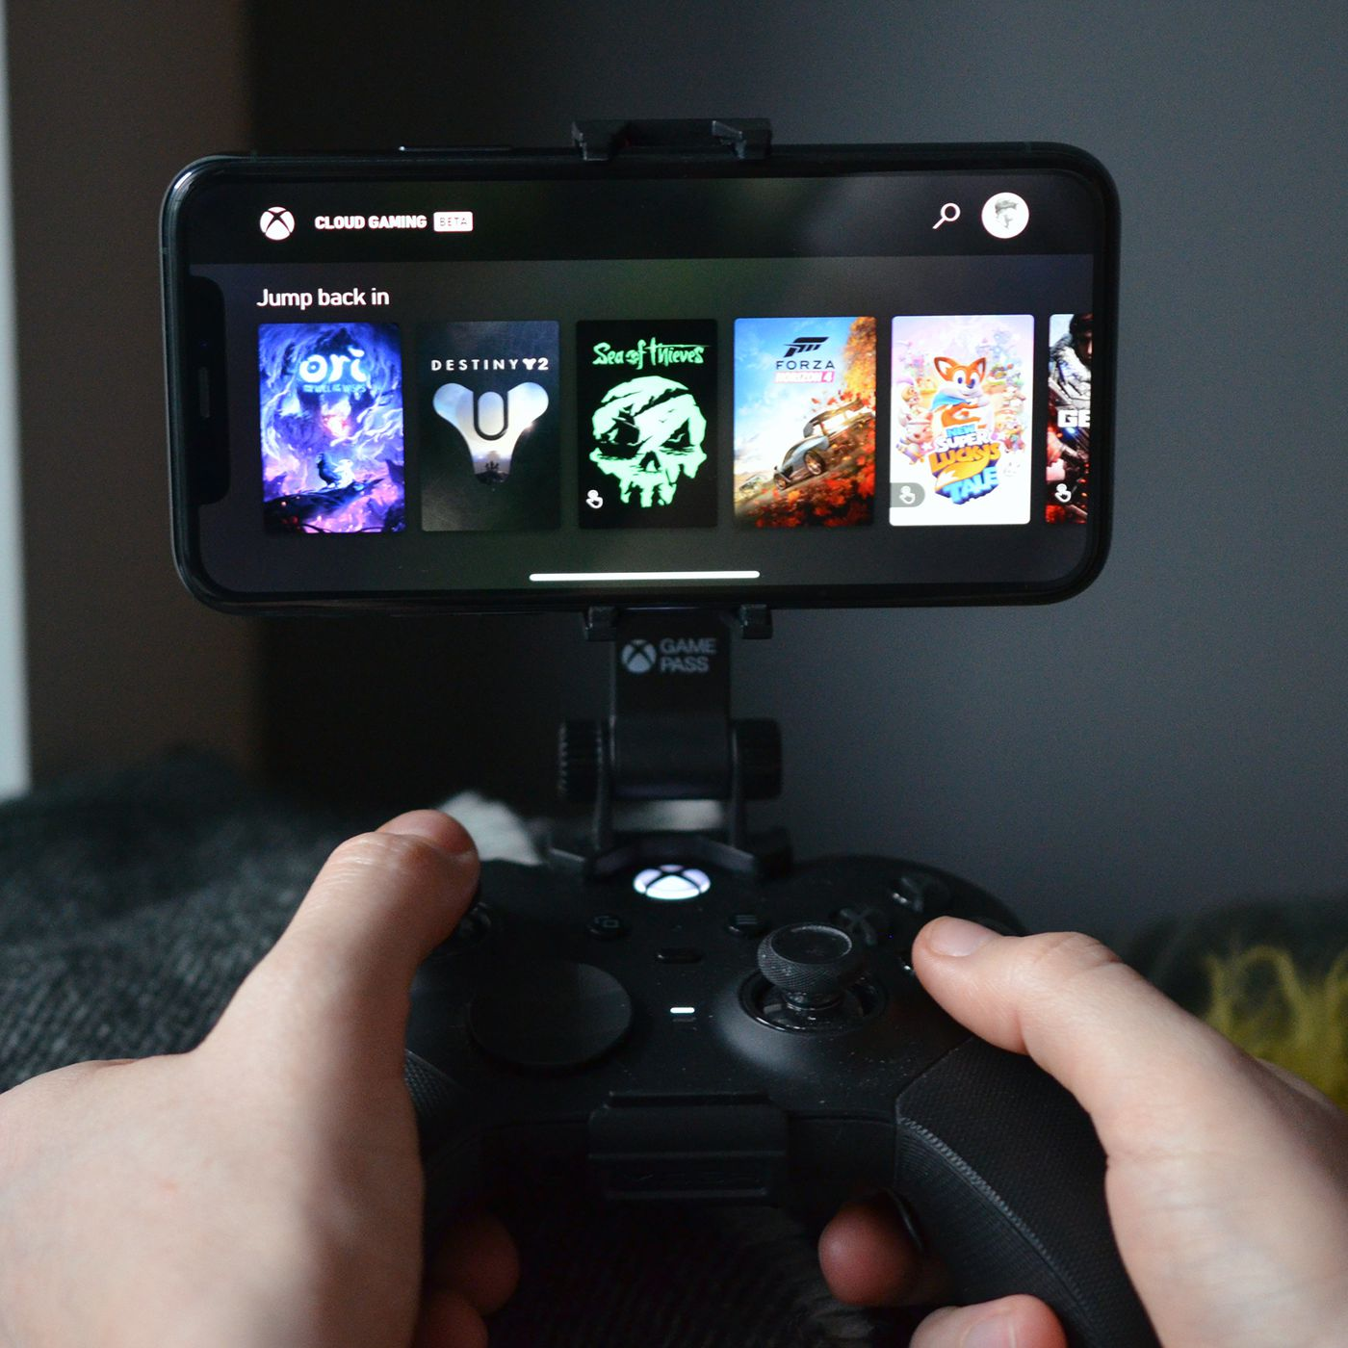
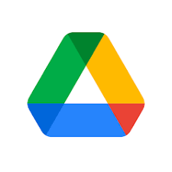
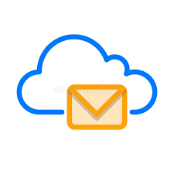
Mobile Cloud app
A Mobile cloud app is an application that operates through the cloud and has a unique combination of characteristics from both, pure desktop apps and pure web apps. This is a software program where cloud-based and local components work together in a congruent manner.
Popular examples of cloud mobile apps include Dropbox, Asana, and Apple’s iCloud services.
characteristics of a cloud app:
Cloud infrastructure (a specific form of information architecture) is used to store data
Here, the data can be locally cached
There is scope of accommodating different user requirements in cloud app development
Cloud apps may be accessed from the desktop or mobile devices alike
Cloud Apps facilitate access to a whole new range of services

Slide 9
How mobile cloud apps works?
At a remote data center operated generally by a third-party, data is stored, and compute cycles are carried out. The uptime, integration, and security aspects are taken care of by a back end that also supports a multitude of access methods.
Cloud applications are known for their responsiveness and the fact that they need not be permanently stored on the device. These apps can function quite well online, but they need to be updated in the online mode.
Cloud apps can be placed under constant control, but they do not always occupy any storage space on a computer or communications device. Provided there is the availability of decent internet connectivity and the cloud app is written well, it is sure to offer the same experience as that of a desktop application while offering the portability of a web app.

Slide 10
Mobile app vs Mobile cloud app
Mobile app
Mobile cloud app
A native mobile app is installed directly on a mobile device
Faster
Do not have cross platform compatibility
High Security
Expensive to develop
Also works in offline mode
Examples : Facebook, eBay, WebEx
A mobile cloud app does not need to be downloaded and installed on the device
A bit slow compared to mobile app
Have cross platform compatibility
Not much secured compared to mobile app
Cheaper to develop
Always need internet connection
Examples :Evernote, Salesforce
If you are looking for better cross-platform compatibility, mobile cloud apps are the better choice.

Slide 11
Benefits of mcc
Multi tenancy: The application is used to share the hardware resources, and how the users can influence utilization of single application and database to occurrence.
Scalability: Service providers can easily expand or add a service which offers scalability to the mobile users.
Availability: As we are using cloud computing technology, the services will be available to the users all the time even when they will be moving.
Reliability: There is a less chance in the loss of data or applications where these can be stored in the cloud on mobile devices.
Dynamic provisioning: The resources can be added on demand dynamically instead of advance reservation.
Ease of integration: With the help of cloud computing technology, many services from various specialist organizations can be coordinated to meet the versatile client's requests.

Slide 12

Emerging issues in Mobile cloud computing
Privacy and security
Data management
Connection Reliability
Performance
Currently, today’s mobile devices do not have these capabilities. It requires a CPU that can execute large numbers of operations per second, RAM (Random Access Memory) to store data and load code, and a battery that can last a long time.

Slide 13
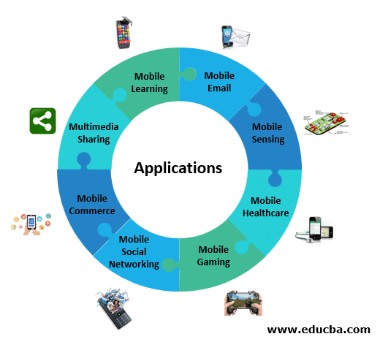
Applications of mcc
Mobile Commerce: Mobile devices using this application provide various business models for commerce. Examples include mobile shopping, mobile advertising, etc.…
Mobile Healthcare: On demand services can be provided by hospitals and healthcare organizations on the clouds by using Mobile healthcare.
Mobile Gaming: This economically benefits service providers to receive potential marketing revenues.
Mobile Learning: This concatenates e-learning and mobility. Limitations with traditional m-learning includes low transmission rate, low cost of device and constrained instructive assets. Cloud based m-learning can comprehend these constraints
Mobile social networking: This lets users store data and share videos in real-time.Examples include Facebook, Twitter ,Instagram, TikTok etc...
Email: If you’re reading your emails on a mobile device such as your smartphone, that’s mobile cloud technology in action.

Slide 14
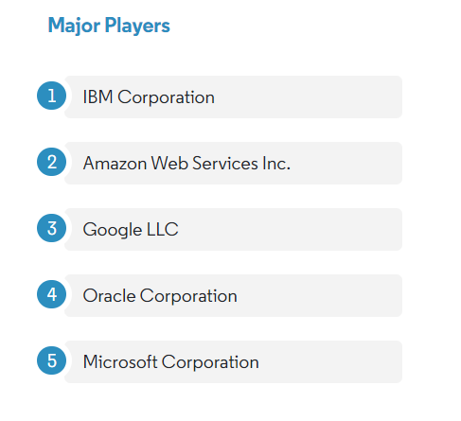
Recent developments
August 2022 - New facilities for Google Cloud are being built in Malaysia, Thailand, and New Zealand as it grows its position in the Asia-Pacific region. Cloud computing services such as Compute Engine, Google Kubernetes Engine, Cloud Storage, Persistent Disk, CloudSQL, Virtual Private Cloud, Key Management System, Cloud Identity, and Secret Manager are also available in this region, where customers can deploy cloud resources. Usually, six months after a new region's opening, more products are accessible.
May 2022 - Sea-Level Operations APAC, a top education company that offers top-notch coaching, education, and tools to assist businesses in the Asia-Pacific region, has been acquired by Pax8, the leading cloud commerce platform. With access to professional coaching, scorecard analytics, and proven training methodologies, this partnership guarantees consistency and collaboration while opening up new avenues for promoting business maturity, efficiency, and operational excellence in service operations and cyber security.

Slide 15
RESEARCH AREAS IN MOBILE CLOUD COMPUTING
Latency
Low Bandwidth
Network Access Management
Quality Of Service
Pricing
Service Convergence
Standard Interface
Energy Efficiency
Security And Privacy
Better Service
Data Delivery
Mobility And Resource Discovery
Mobility And Cloud Session Connectivity
Overhead Due To Use Of Cloud
Reliability
Scalability
High Availability
Overhead Due To Use Of Cloud
Task Division
“Every kid coming out of school now thinks he can be the next Mark Zuckerberg, and with these new technologies like cloud computing, he actually has a shot.”
- Marc Andreessen, Co-founder of Netscape, Board Member of Facebook

Slide 16
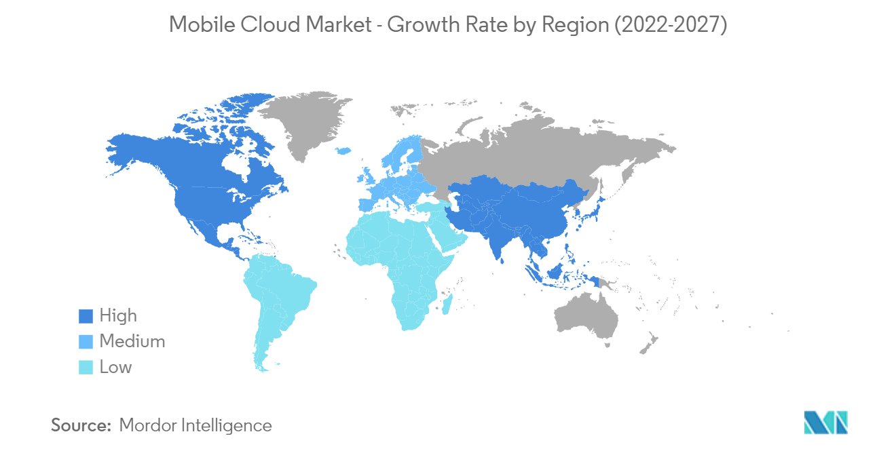
The mobile cloud market is expected to record a CAGR of 25.28% during the forecast period from 2022 to 2027.

Slide 17
conclusion
MCC is an innovative approach to mobile computing that provides users with expanded capabilities and greater flexibility. Through MCC, users can take full advantage of the capacity of their smartphones or tablets by combining the processing power of these devices with that available in the cloud.
Though the benefits of this technology are many, there are certain double-edged swords to not just be aware of, but also stay away from. This is still a technology that is in its nascent stage. The scope and potential of it all seem to be quite promising. The true path that it takes will be a little more clear when more and more companies begin adapting to it and investing in it.
By following cloud security best practices and implementing the appropriate security tools, businesses can minimize risks and take full advantage of the benefits cloud computing offers.

Slide 18
references
Challenging Issues and Limitations of Mobile Computing: Deepak Getal, Int. J. Computer Technology & Applications, Vol 3 (1),177-181
Mobile Cloud Computing Service Models: A User Centric Approach JEEVAN J,RAMLING HALMANDGE,PUSHPALATHA S
A Survey of Mobile Cloud Computing: Architecture, Applications, and Approaches Hoang T. Dinh, Chonho Lee, DusitNiyato, and Ping Wang
Research on Mobile Cloud Computing: Review, Trend and Perspectives Han Qi, Abdullah Gani
M. Satyanarayanan, “Mobile computing: the next decade,” in Proceedings of the 1st ACM Workshop on Mobile Cloud Computing & Services: Social Networks and Beyond (MCS), June 2010
White Paper. Mobile Cloud Computing Solution Brief. AEPONA, 2010
Mobile Cloud Computing Service Models: A User Centric Approach JEEVAN J,RAMLING HALMANDGE,PUSHPALATHA S
https://journals.plos.org/plosone/article?id=10.1371/journal.pone.0234312
Mobile cloud computing – Wikipedia
http://en.wikipedia.org/wiki/Mobile_communication
Mobile telephony – Wikipedia
5 top challenges in Mobile Cloud Computing | Technology and Web security Stuffs (wordpress.com)

Slide 19
Thank you

